Slide 1
S2-19_DSECLZC415 Classification and Prediction
Slide Courtesy: Prof. T.V. Rao

Slide 2

The slides presented here are obtained from the authors of the books and from various other contributors. I hereby acknowledge all the contributors for their material and inputs.
I have added and modified a few slides to suit the requirements of the course.

Slide 3
Prediction

Slide 4
Prediction vs. Classification
How is (Numerical) prediction similar to classification?
construct a model
use model to predict continuous or ordered value for a given input
Difference between Prediction and classification
Classification refers to predict categorical class label
Prediction models continuous-valued functions
Major method for prediction: regression
model the relationship between one or more independent or predictor variables and a dependent or response variable
Profit, sales, mortgage rates, house values, square footage, temperature, or distance could all be predicted using regression techniques. For example, a regression model could be used to predict the value of a house based on location, number of rooms, lot size, and other factors.

Slide 5
Regression for Prediction
A regression task begins with a (training) data set in which the target values are known,
e.g., a regression model that predicts house values could be developed based on observed data for many houses over a period of time.
The data might track
the age of the house,
square footage,
number of rooms,
taxes,
school district,
proximity to shopping centers,
and so on.
House value would be the target, the other attributes would be the predictors, and the data for each house would constitute a case.

Slide 6
Regression for Prediction
In the model build (training) process, a regression algorithm estimates the value of the target as a function of the predictors for each case in the build data.
These relationships between predictors and target are summarized in a model
Model can then be applied to a different data set in which the target values are unknown

Slide 7
Prediction Techniques
Regression analysis
Linear and multiple regression
Non-linear regression
Other regression methods: generalized linear model, Poisson regression, log-linear models, regression trees

Slide 8
Regression analysis
Regression analysis seeks to determine the values of parameters for a function that cause the function to best fit a set of data observations that you provide.
The following equation expresses these relationships in symbols. It shows that regression is the process of estimating the value of a continuous target (y) as a function (F) of one or more predictors (x1 , x2 , ..., xn), a set of parameters (w1 , w2 , ..., wn), and a measure of error (e).
y = F(x,w) + e
The predictors can be understood as independent variables and the target as a dependent variable. The error, also called the residual, is the difference between the expected and predicted value of the dependent variable. The regression parameters are also known as regression coefficients.
The process of training a regression model involves finding the parameter values that minimize a measure of the error, for example, the sum of squared errors.

Slide 9
Linear Regression
Linear regression: involves a response variable y and a single predictor variable x
y = w₀ + w₁ x
where w₀ (y-intercept) and w₁ (slope) are regression coefficients
Method of least squares: estimates the best-fitting straight line
Multiple linear regression: involves more than one predictor variable
Training data is of the form (X₁, y₁), (X₂, y₂),…, (X_{|D|}, y_{|D|})
Ex. For 2-D data, we may have: y = w₀ + w₁ x₁+ w₂ x₂
Solvable by extension of least square method or using SAS, S-Plus
Many nonlinear functions can be transformed into the above

Slide 10
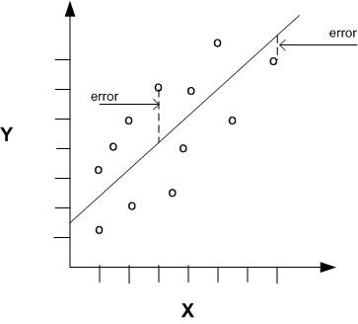
Linear Regression With a Single Predictor

Slide 11
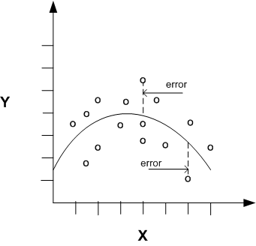
Nonlinear Regression
Often the relationship between x and y cannot be approximated with a straight line. In this case, a nonlinear regression technique may be used. Alternatively, the data could be preprocessed to make the relationship linear.
Nonlinear regression models define y as a function of x using an equation that is more complicated than the linear regression equation

Slide 12
Nonlinear Regression
Some nonlinear models can be modeled by a polynomial function
A polynomial regression model can be transformed into linear regression model. For example,
y = w₀ + w₁ x + w₂ x² + w₃ x³
convertible to linear with new variables: x₂ = x², x₃= x³
y = w₀ + w₁ x + w₂ x₂ + w₃ x₃
Other functions, such as power function, can also be transformed to linear model
Some models are intractable nonlinear (e.g., sum of exponential terms)
possible to obtain least square estimates through extensive calculation on more complex formulae

Slide 13
Regression Trees and Model Trees
Regression tree: proposed in CART system (Breiman et al. 1984)
CART: Classification And Regression Trees
Each leaf stores a continuous-valued prediction
It is the average value of the predicted attribute for the training tuples that reach the leaf
Model tree: proposed by Quinlan (1992)
Each leaf holds a regression model—a multivariate linear equation for the predicted attribute
A more general case than regression tree
Regression and model trees tend to be more accurate than linear regression when the data are not represented well by a simple linear model

Slide 14
Model Evaluation and Selection

Slide 15
Model Evaluation and Selection
Evaluation metrics: How can we measure accuracy? Other metrics to consider?
Use validation test set of class-labeled tuples instead of training set when assessing accuracy
Methods for estimating a classifier’s accuracy:
Holdout method, random subsampling
Cross-validation
Bootstrap
Comparing classifiers:
Cost-benefit analysis and ROC Curves
15

Slide 16
Classifier Evaluation Metrics: Confusion Matrix
Confusion Matrix:
Given m classes, an entry, CM_{i,j} in a confusion matrix indicates # of tuples in class i that were labeled by the classifier as class j
May have extra rows/columns to provide totals
Predicted class -> | C₁ | ¬ C₁
Actual class⇓
C₁ | True Positives (TP) | False Negatives (FN)
¬ C₁ | False Positives (FP) | True Negatives (TN)
16

Slide 17
Classifier Evaluation Metrics: Confusion Matrix
Example of Confusion Matrix:
Predicted class -> | buy_computer = yes | buy_computer = no | Total
Actual class ⇓
buy_computer = yes | 6954 | 46 | 7000
buy_computer = no | 412 | 2588 | 3000
Total | 7366 | 2634 | 10000
17

Slide 18
Classifier Evaluation Metrics: Accuracy, Error Rate, Sensitivity and Specificity
Class Imbalance Problem:
One class may be rare, e.g. fraud, or HIV-positive
Significant majority of the negative class and minority of the positive class
Sensitivity: True Positive recognition rate
Sensitivity = TP/P
Specificity: True Negative recognition rate
Specificity = TN/N
Classifier Accuracy, or recognition rate:
percentage of test set tuples that are
correctly classified
Accuracy = (TP + TN)/All
Error rate: 1 – accuracy, or
Error rate = (FP + FN)/All
A\P | C | ¬C
C | TP | FN | P
¬C | FP | TN | N
 | P’ | N’ | All
18

Slide 19
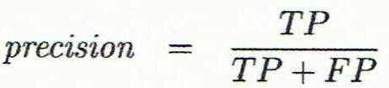
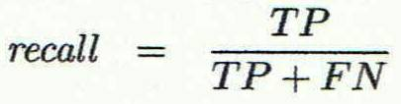
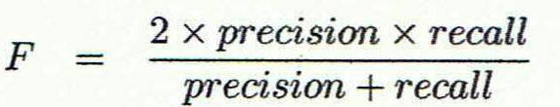
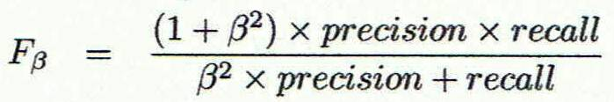
Classifier Evaluation Metrics: Precision and Recall, and F-measures
Precision: exactness – what % of tuples that the classifier labeled as positive are actually positive
Recall: completeness – what % of positive tuples did the classifier label as positive?
Perfect score is 1.0
Inverse relationship between precision & recall
F measure (F₁ or F-score): harmonic mean of precision and recall,
F_{ß}: weighted measure of precision and recall
assigns ß times as much weight to recall as to precision
19

Slide 20
Classifier Evaluation Metrics: Example
Precision = 90/230 = 39.13% Recall = 90/300 = 30.00%
Actual Class\Predicted class | cancer = yes | cancer = no | Total | Recognition(%)
cancer = yes | 90 | 210 | 300 | 30.00 (sensitivity
cancer = no | 140 | 9560 | 9700 | 98.56 (specificity)
Total | 230 | 9770 | 10000 | 96.40 (accuracy)
20

Slide 21
Evaluating Classifier Accuracy: Holdout & Cross-Validation Methods
Holdout method
Given data is randomly partitioned into two independent sets
Training set (e.g., 2/3) for model construction
Test set (e.g., 1/3) for accuracy estimation
Random sampling: a variation of holdout
Repeat holdout k times, accuracy = avg. of the accuracies obtained
Cross-validation (k-fold, where k = 10 is most popular)
Randomly partition the data into k mutually exclusive subsets, each approximately equal size
At i-th iteration, use D_{i} as test set and others as training set
Leave-one-out: k folds where k = # of tuples, for small sized data
*Stratified cross-validation*: folds are stratified so that class dist. in each fold is approx. the same as that in the initial data
21

Slide 22

Evaluating Classifier Accuracy: Bootstrap
Bootstrap
Works well with small data sets
Samples the given training tuples uniformly with replacement
i.e., each time a tuple is selected, it is equally likely to be selected again and re-added to the training set
Several bootstrap methods, and a common one is .632 boostrap
A data set with d tuples is sampled d times, with replacement, resulting in a training set of d samples. The data tuples that did not make it into the training set end up forming the test set. About 63.2% of the original data end up in the bootstrap, and the remaining 36.8% form the test set (since (1 – 1/d)^{d} ≈ e⁻¹ = 0.368)
Repeat the sampling procedure k times, overall accuracy of the model:
22

Slide 23
Model Selection: ROC Curves
ROC (Receiver Operating Characteristics) curves: for visual comparison of classification models
Originated from signal detection theory
Shows the trade-off between the true positive rate and the false positive rate
The area under the ROC curve is a measure of the accuracy of the model
Rank the test tuples in decreasing order: the one that is most likely to belong to the positive class appears at the top of the list
The closer to the diagonal line (i.e., the closer the area is to 0.5), the less accurate is the model
Vertical axis represents the true positive rate
Horizontal axis rep. the false positive rate
The plot also shows a diagonal line
A model with perfect accuracy will have an area of 1.0
23

Slide 24
Prescribed Text Books
 | Author(s), Title, Edition, Publishing House
T1 | Tan P. N., Steinbach M & Kumar V. “Introduction to Data Mining” Pearson Education
T2 | Data Mining: Concepts and Techniques, Third Edition by Jiawei Han, Micheline Kamber and Jian Pei Morgan Kaufmann Publishers
R2 | Principles of Data Mining, Second Edition by Max Bramer Springer © 2013
R1 | Predictive Analytics and Data Mining: Concepts and Practice with RapidMiner by Vijay Kotu and Bala Deshpande Morgan Kaufmann Publishers

Slide 25
Thank You

